Slide 1





Welcome to the Webinar Offered by: National Microelectronics Security Training (MEST) Center
Sponsors:
Notes:
Welcome to the Microelectronics…webinar titled this this
Until 12:03 or send to instructor to have them keep slide for the first 5-8 minutes MEST Logo title and logo name
Uf logo and OSU logo, sponsors AFRL and Nimbis.

Slide 2

Introduction to System on Chip System Integration
Abigail Butka, Kawser Ahmed Muhammed, Christophe Bobda
National Micro Electronics Security Training (MEST) Center

Slide 3
Agenda
Introduction and Motivation
Sysem on Chip
Definition
Benefits
Challenges
Applications
Basic Lab Architecture
Conclusion and Discussion
National Micro Electronics Security Training (MEST) Center

Slide 4
SoC- Architecture
Software
Tasks
Program
memory
Processor
Peripheral
SW Interface
Bus
HA Interface
…
IP1
IP3
Peripheral
IP2
National Micro Electronics Security Training (MEST) Center

Slide 5
System Integration

Slide 6
Interfacing: I/O addressing
On a PCB a microprocessor communicates with other IP using some of its pins.
On SoCs, ports are used for communication.
Two interfacing approaches
Port-based I/O (parallel I/O)
Processor has one or more N-bit ports
Processor’s software reads and writes a port just like a register
E.g., P0 = 0xFF; v = P1.2; -- P0 and P1 are 8-bit ports
Bus-based I/O
Processor has address, data and control ports that form a single bus
Communication protocol is built into the processor
A single instruction carries out the read or write protocol on the bus
Processor
memory
Processor
Bus
IP1
IP2
© Frank Vahid and Tony Givargis
National Micro Electronics Security Training (MEST) Center

Slide 7
Bus-based I/O: Memory-mapped and standard I/O
Processor talks to both memory and peripherals using same bus – two ways to talk to peripherals
Memory-mapped I/O
Peripheral registers occupy addresses in same address space as memory
e.g., Bus has 16-bit address
lower 32K addresses may correspond to memory
upper 32k addresses may correspond to peripherals
Standard I/O (I/O-mapped I/O)
Additional pin (M/IO) on bus indicates whether a memory or peripheral access
e.g., Bus has 16-bit address
all 64K addresses correspond to memory when M/IO set to 0
all 64K addresses correspond to peripherals when M/IO set to 1
memory
Processor
Bus
IP1
IP2
memory
Processor
Bus
IP1
IP2
National Micro Electronics Security Training (MEST) Center

Slide 8
Bus-based I/O: Memory-mapped and standard I/O
Memory-mapped I/O
Requires no special instructions
Assembly instructions involving memory like MOV and ADD work with peripherals as well
Standard I/O requires special instructions (e.g., IN, OUT) to move data between peripheral registers and memory
Standard I/O
No loss of memory addresses to peripherals
Simpler address decoding logic in peripherals possible
When number of peripherals much smaller than address space then high-order address bits can be ignored
smaller and/or faster comparators
memory
Processor
Bus
IP1
IP2
memory
Processor
Bus
IP1
IP2
National Micro Electronics Security Training (MEST) Center

Slide 9
Interconnect

Slide 10
SoC Interconnect: Multilevel bus architectures
Processor-local bus
High speed, wide, most frequent communication
Connects microprocessor, cache, memory controllers, etc.
Peripheral bus
Lower speed, narrower, less frequent communication
Typically, industry standard bus (ISA, PCI) for portability
Bridge
Single-purpose processor converts communication between busses
Micro-
processor
Cache
Memory
controller
DMA
controller
Processor-local bus
Peripheral
Peripheral
Peripheral
Bridge
Peripheral bus
National Micro Electronics Security Training (MEST) Center

Slide 11
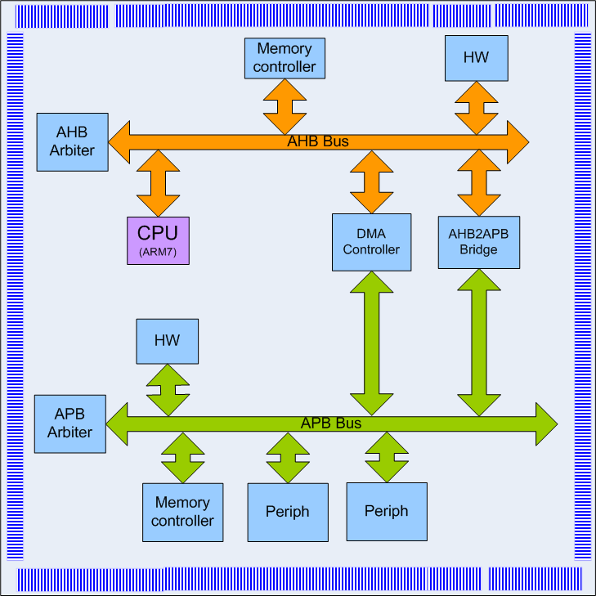
SoC Interconnect: Multilevel bus architectures - ARM’s AMBA
Advanced Microcontroller Bus Architecture (Introduced by ARM in 96)
Open standard, on-chip interconnect specification for the connection and management of functional blocks in a System-on-Chip (SoC)
32-bit addressing
Early SoC Architectures
high-performance system interconnect
Advanced System Bus (ASB): Version 1
Advance High-Speed Bus (AHB): Version 2
Low-speed peripheral bus:
Advance Peripheral Bus (APB): Version 1 & 2
Cross Communication via a bridge
2003: 3rd generation, including AXI for connection of memory mapped components, with Advanced Trace Bus (ATB)
2010: 4th generation, AMBA4, incl AXI4 2011: 5th generation, AMBA5
2013: 5th generation AMBA5 with CHI (Coherent Hub Interface)
National Micro Electronics Security Training (MEST) Center

Slide 12
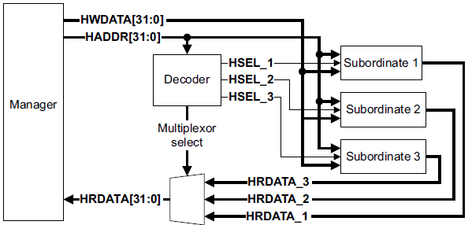
SoC Interconnect: Multilevel bus architectures - ARM’s AMBA
Defines the interface between
Managers (Master)
interconnects (Medium, Protocol)
Subordinates (Slave)
APB integration through a bridge
Operation
Managers place read and write request and subordinates respond
Transfers can be single or burst
The write data bus moves data from the Manager to a Subordinate, and the read data bus moves data from a Subordinate to the Manager
Every transfer consists of Address phase and Data phase
Strobe protocol using 4 clock cycle
Wait cycle can be introduced by slave
Subordinate HRESP to indicate the success or failure of a transfer
National Micro Electronics Security Training (MEST) Center

Slide 13
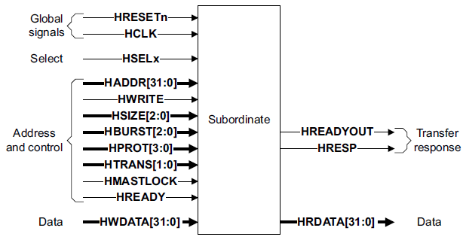
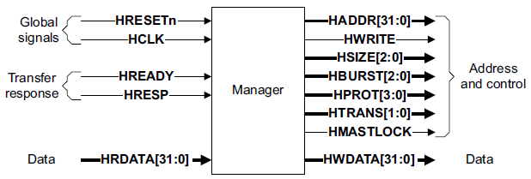
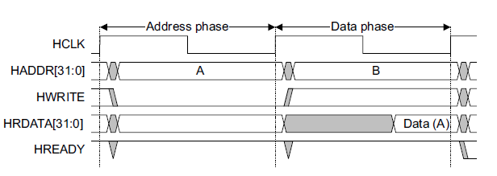
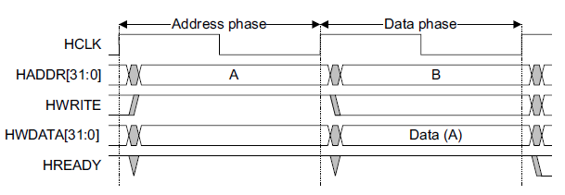
SoC Interconnect: Multilevel bus architectures - ARM’s AMBA - AHB
Manager
Initiate and control read and write operations
Subordinate
A Subordinate responds to transfers initiated by Managers
HSELx selects subordinate
Subordinate signals back to the Manager:
The completion or extension of the bus transfer
The success or failure of the bus transfer.
Basic transfers
HWRITE = 1 for write transfer: Manager Place data on the bus
HWRITE = 1 = 0 for read transfers:
Selected subordinate places data on the bus
The simplest transfer is one with no wait states
one address cycle and one data cycle
Read Transfer
Write Transfer
National Micro Electronics Security Training (MEST) Center

Slide 14
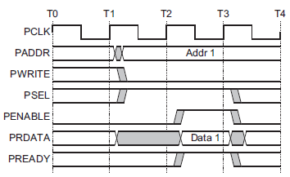
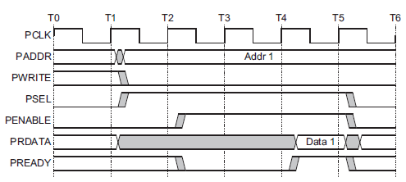
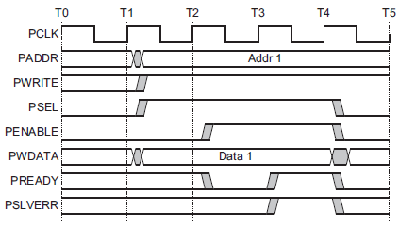
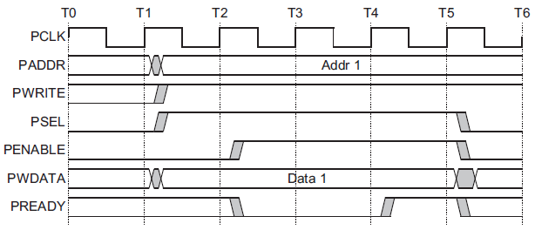
SoC Interconnect: Multilevel bus architectures - ARM’s AMBA - APB
Transfer controlled by a master (bridge) and a slave
Structure like AHB
Strobe transfer on 4 cycles
Read transfer, no wait Cycles
Read transfer with 1wait Cycles
Write transfer, no wait Cycles
write transfer with 1 wait Cycles
National Micro Electronics Security Training (MEST) Center

Slide 15
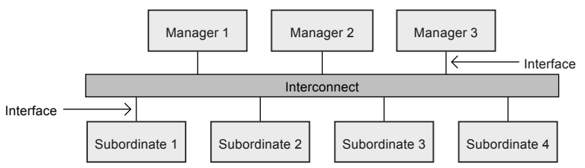
SoC Interconnect: Multilevel bus architectures - ARM’s AMBA - AXI
Burst-based protocol with five independent transaction channels
All channels share the same handshaking mechanism
Read address, which has signal names beginning with AR.
Read data, which has signal names beginning with R.
Write address, which has signal names beginning with AW.
Write data, which has signal names beginning with W.
Write response, which has signal names beginning with B.
Address channel carries control information that describes the nature of the data to be transferred
Data transferred between Manager and Subordinate using either:
A write data channel to transfer data from the Manager to the Subordinate. Subordinate responds on uses the write response
A read data channel to transfer data from the Subordinate to the Manager
valid
source
dest
ready
AXI Channel
National Micro Electronics Security Training (MEST) Center

Slide 16
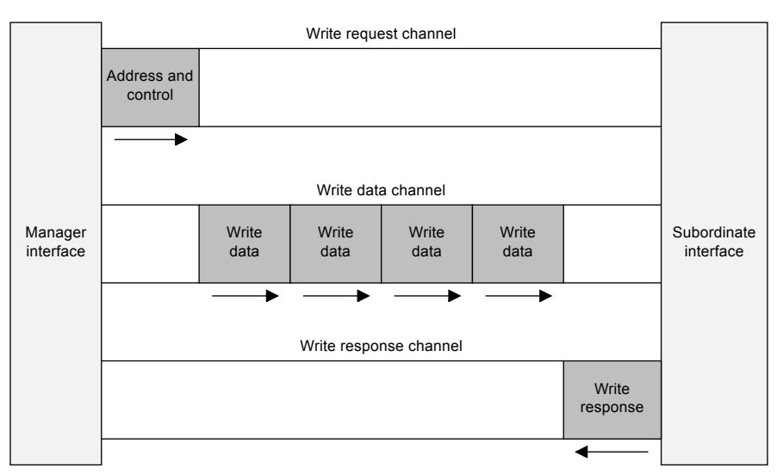
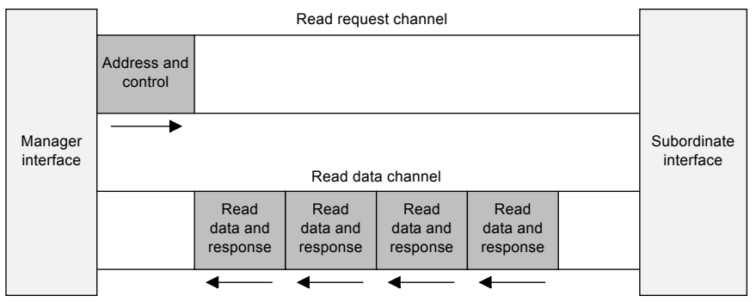
SoC Interconnect: Multilevel bus architectures - ARM’s AMBA - AXI
Address information can be issued ahead of the actual data transfer
Supports multiple outstanding transactions
Supports out-of-order completion of transactions
Transfers and transactions
A transfer is a single exchange of information, with one VALID and READY handshake
A transaction is an entire burst of transfers, containing an address transfer, one or more data transfers, and, for write sequences, a response transfer
National Micro Electronics Security Training (MEST) Center

Slide 17
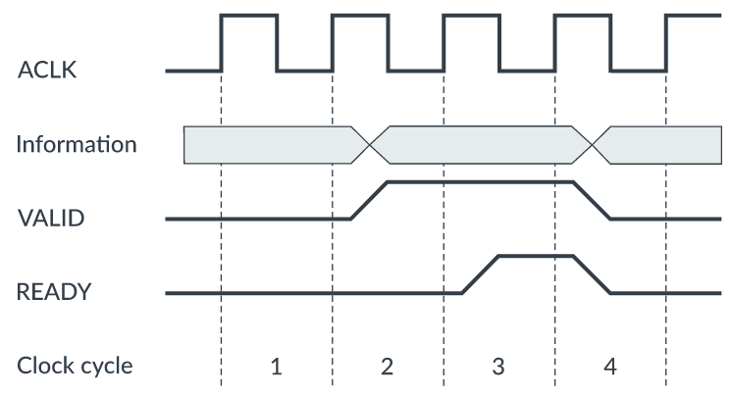
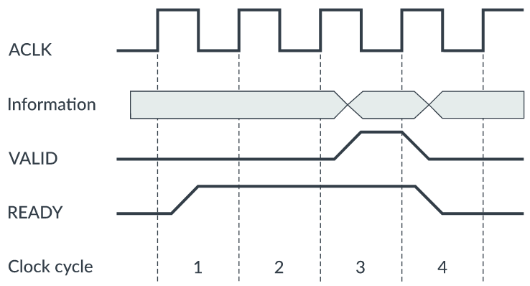
SoC Interconnect: Multilevel bus architectures - ARM’s AMBA - AXI
Transfer Examples
In clock cycle 2, the VALID signal is asserted, indicating that the data on the information channel is valid.
In clock cycle 3, the following clock cycle, the READY signal is asserted.
The handshake completes on the rising edge of clock cycle 4, because both READY and VALID signals are asserted.
In clock cycle 1, the READY signal is asserted.
The VALID signal is not asserted until clock cycle 3.
The handshake completes on the rising edge of clock cycle 4, when both VALID and READY are asserted.
National Micro Electronics Security Training (MEST) Center

Slide 18
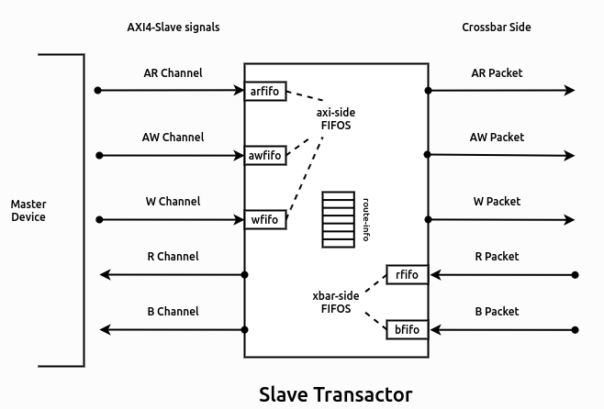
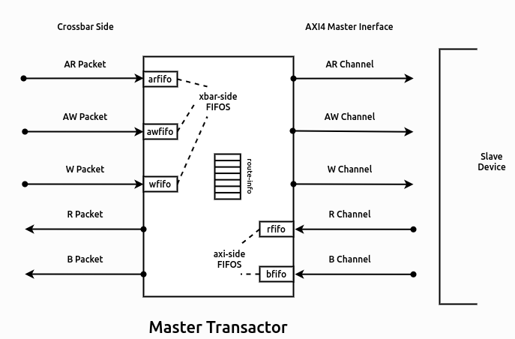
SoC Interconnect: Multilevel bus architectures - ARM’s AMBA - AXI
Crossbar switch: internally instantiates
M slave transactors and S master transactors
A transactors provide
an AXI4 interface on one side (driving the external signals of the cross-bar) and a FIFO like interface on the other side.
The slave transactors provide an AXI4 slave interface externally to connect master devices (DMA masters, cache masters, etc.)
The master transactors provide an AXI4 master interface externally, to connected slave devices (UART, SPI, Memory controllers, etc.)
National Micro Electronics Security Training (MEST) Center

Slide 19
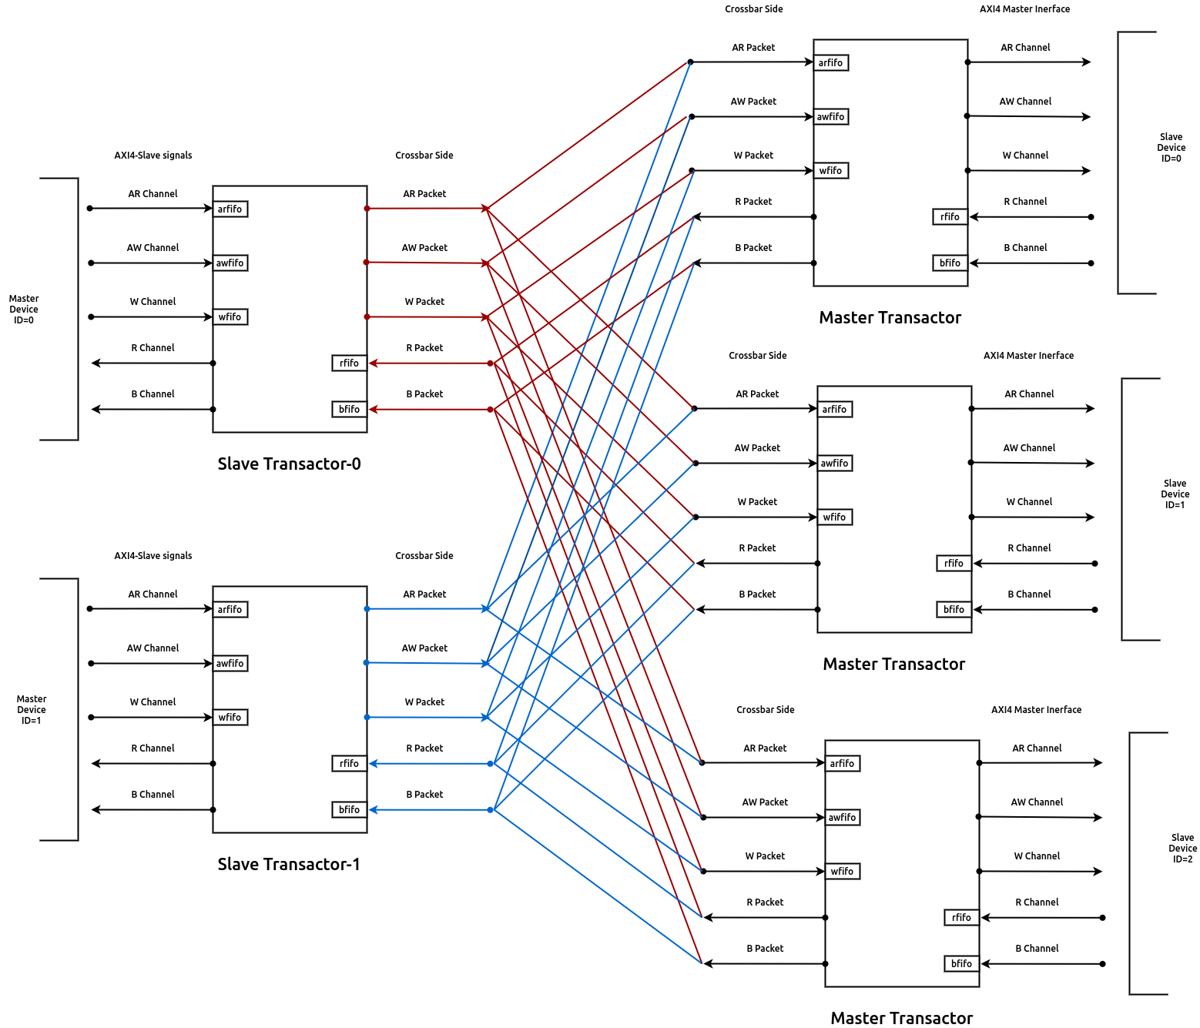
SoC Interconnect: Multilevel bus architectures - ARM’s AMBA - AXI
National Micro Electronics Security Training (MEST) Center

Slide 20
Case Study and Tutorial

